Slide 1


CAPSTONE PROJECT
analyzing green consumer behavior
Presented By
Student Name : Divye jaiswal
College Name : ITER (Institute of Technical Education and Research)
Department : csit
Email ID : divyejaiswal5@gmail.com

Slide 2
OUTLINE:
Problem Statement
Proposed System/Solution
System Development Approach
Algorithm & Deployment
Result
Conclusion
Future Scope
References

Slide 3
Problem Statement:
It feels like everyone’s more aware of eco-friendly products these days, but for businesses, figuring out what really makes someone choose that sustainable option over a regular one is still a major puzzle—factors like age, income, how much they know about the environment, or even a simple recommendation from a friend can all play a part, yet without digging into the actual data to spot these patterns, companies are just left guessing how to connect with the people who actually want to buy green.
Hence we need to analyze consumer behavior and visualize key trends to encourage green consumption.

Slide 4
Proposed Solution:
The goal of this is to develop a solution which would easily tell you why people buy eco-friendly stuff and how much they buy instead of us guessing for hours. So now we don’t have to just assume instead we have the real data and values ,this project takes a step back and actually looks at real customer data to see what's really happening. The solution will consist of the following components:
Data Collection:
We start by gathering all available data. This includes basic information like age, gender, and income, as well as online behaviors and social influences. We're also looking at finer details that could be significant, such as whether they're shopping on a mobile device or a computer, how much time they spend looking at sustainable products, and what initially sparked their interest—a friend's recommendation, an advertisement, or a social media post.
Data Preprocessing:
First I cleaned the data by removing the null values and other irregularities such as changing the data column to the correct data types,etc.
After which checking if there is no error then making sure that we keep all the important data together and giving them names by which I can further access them for the use.
Looking for patterns :
Once the data's clean, I start poking around to see what trends pop up. Maybe it turns out younger folks are way more into green products than we thought. Or maybe people who score high on "social influence" (meaning they care what their friends think) are actually the ones buying sustainable stuff. I then build interactive charts and graphs so you can actually see these patterns, not just read about them in some dense report.
Finally displaying all the results :
The final piece is to give all the charts and details I have created in Power BI dashboard to the other peoples so that they can understand and see everything clearly not in complex type so it can cause a positive impact for the society .

Slide 5
System Approach:
This section describes the strategy I have used here to analyze green consumer behavior and visualize the insights using data analytics tools. The approach is simple to focus on collecting consumer behavior data, processing it properly, and presenting meaningful insights with the help of an interactive dashboard I have created in Microsoft Power BI. This method helps identify patterns in green product purchasing and understand the factors influencing sustainable consumption. :
System requirements
A computer or laptop with basic processing capability
Stable internet connection for downloading datasets and tools
Microsoft Power BI for data visualization and dashboard creation
Microsoft Excel for viewing and preparing the datase

Slide 6
Libraries / Tools Required :
Microsoft Power BI – used for data analysis, modeling, and creating interactive dashboards
Microsoft Excel – used for checking and organizing the dataset before importing into Power BI
Built-in visualization tools such as bar charts, pie charts, and slicers for presenting insights about green consumer behavior.

Slide 7
Algorithm & Deployment:
Algorithm Selection :
The project uses a data analysis and visualization approach to study green consumer behavior. Instead of predictive machine learning models, the system focuses on analyzing consumer data and identifying patterns related to sustainable product purchases. Microsoft Power BI is used to transform the dataset into meaningful visual insights.
Data Input :
The system uses consumer behavior data containing attributes such as age, gender, income level, product category, social influence score, green knowledge level, device type, and previous green purchases. These inputs help in understanding the factors influencing green product consumption .
Data Processing :
The dataset is cleaned and organized before analysis. Unnecessary values are removed, and the data is structured properly for visualization. Relevant fields are selected to analyze relationships between demographic factors and green purchasing behavior .

Slide 8
Visualization & Insight Generation :
Interactive dashboards are created in Microsoft Power BI using charts such as bar charts, pie charts, and column charts. These visualizations help identify consumer trends, product preferences, and the impact of different factors on green product purchases.
Deployment
The final dashboard is deployed within Microsoft Power BI, allowing users to explore consumer behavior through filters and interactive visuals. This helps businesses and researchers better understand sustainable consumption patterns.

Slide 9
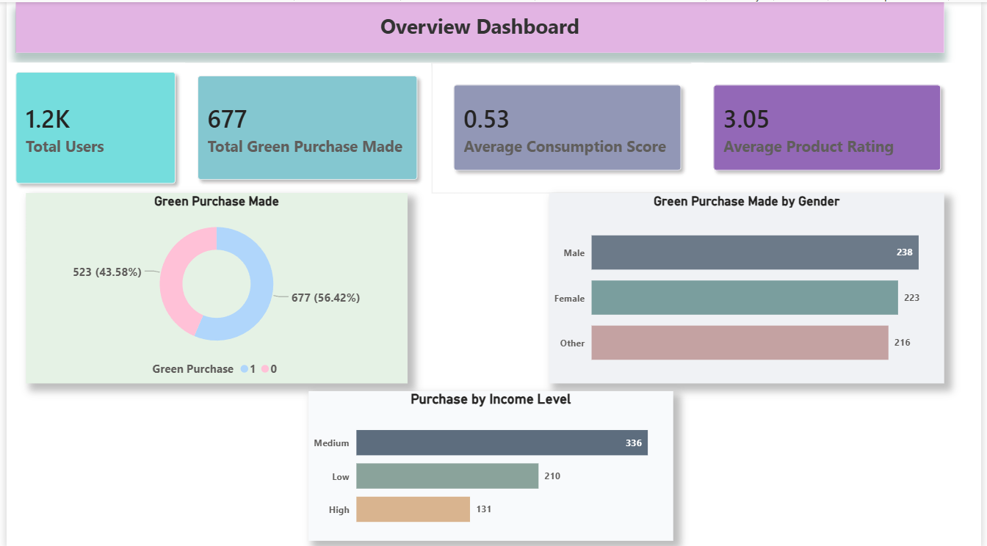
Result :
Github Link : https://github.com/iamdivye/Microsoft-PowerBI

Slide 10
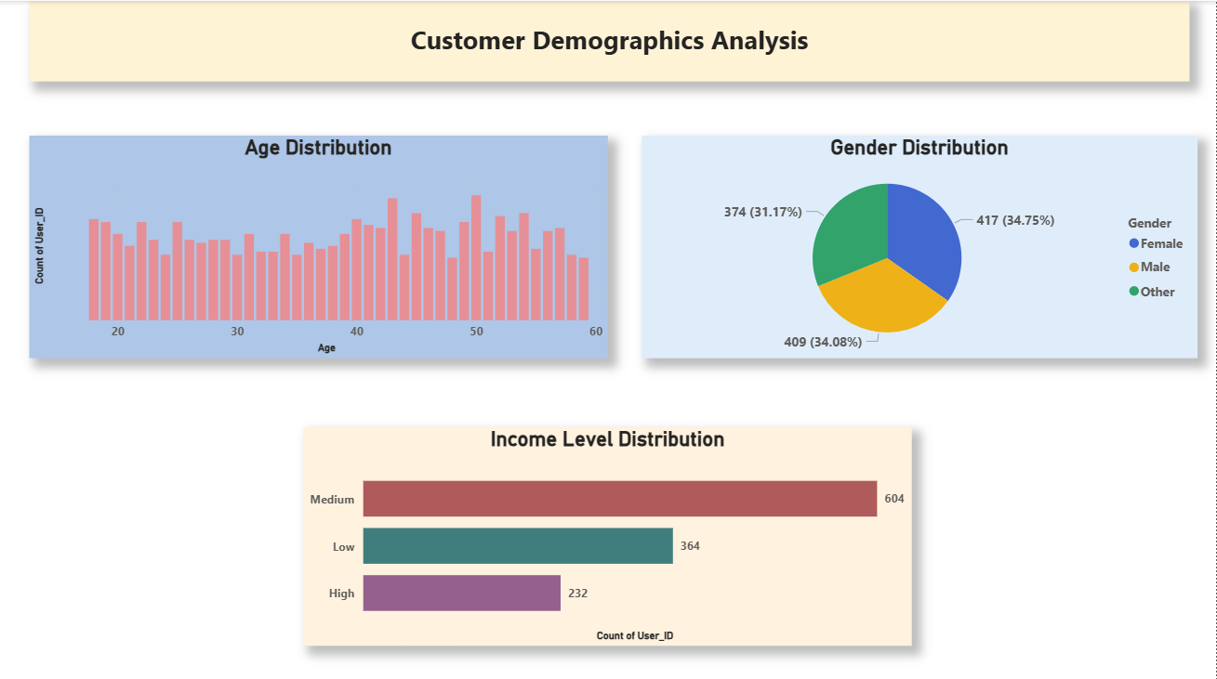

Slide 11
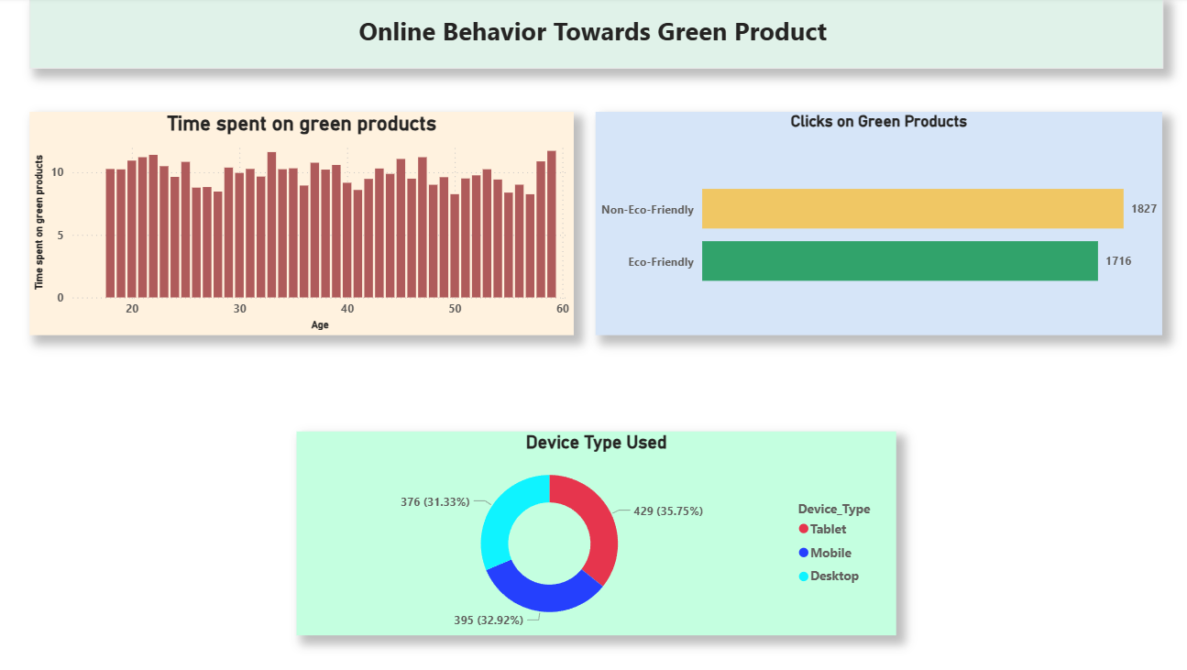

Slide 12
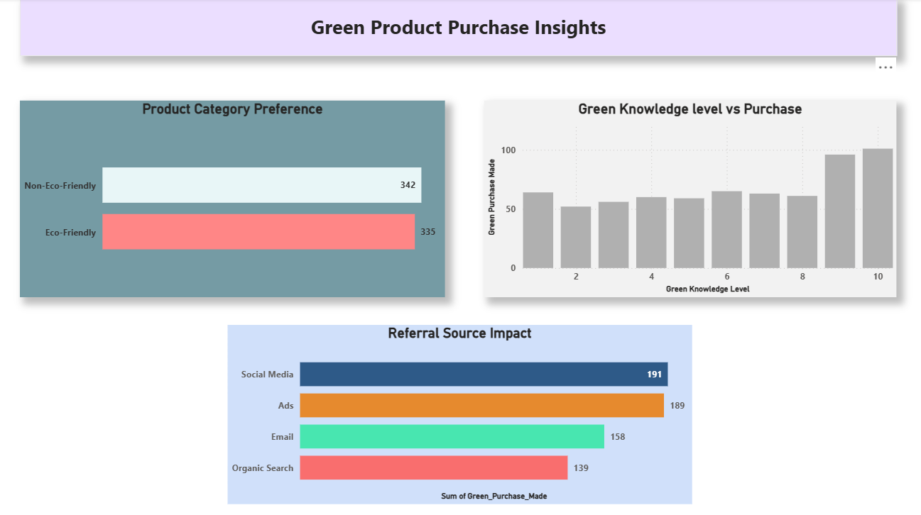

Slide 13
Conclusion:
So here's what we actually did—we dug into how people shop for eco-friendly products by building some interactive dashboards in Power BI. We looked at things like age, gender, income, what kinds of products they were buying, and whether their social circle seemed to influence them. Once we started visualizing all that, some interesting patterns popped up around who's actually buying green and what's driving those decisions.
The dashboard makes it pretty easy to see, for example, whether younger shoppers are more likely to choose sustainable options or if income level plays a bigger role than we thought. It's helpful for businesses trying to figure out their audience, or researchers wanting to understand what makes people tick when it comes to eco-friendly stuff. At the end of the day, the whole project just shows that when you take raw data and actually visualize it, the story behind all those numbers starts to make a whole lot more sense.

Slide 14
Future scope:
Honestly, there's so much more I could do with this if I really wanted to dig deep. Like, imagine if I could pull in way bigger datasets—not just the usual stuff, but real-time purchase data, like what people are actually buying right this second, or even scrolling through social media comments to see what people are saying about eco-friendly products when they think no one's watching. That would give such a richer picture of what's really going on in people's heads when they decide to go green.
And wouldn't it be cool to expand this across different cities or even countries? I'd love to see how someone in, say, Berlin shops for sustainable stuff compared to someone in a smaller town in the Midwest. I'd probably find some wild differences—maybe one region is all about the label, while another couldn't care less unless it's affordable. That kind of comparison could actually help businesses tailor their approach instead of just throwing the same message everywhere and hoping it sticks.
Also, let's be real—I’m sitting on a goldmine of advanced analytics these days. Throwing some machine learning into the mix could help me spot trends before they even happen. Instead of just looking back at what people did, I could start predicting where things are heading. Like, maybe I'd catch onto a growing interest in refillable products six months before it becomes a whole thing.
The ultimate dream though? Connecting all of this to live data so the dashboard just... updates itself. No more waiting around for the next report—just open it up and see what's shifting in real time. Businesses could react on the fly, policymakers could spot problems faster, and honestly, it might actually help more people make the switch to sustainable shopping if I can figure out what's holding them back right now.

Slide 15
References:
GitHub Link (my solution) : https://github.com/iamdivye/Microsoft-PowerBI
DataSet : https://www.kaggle.com/datasets/freshersstaff/green-consumption-behavior-dataset?resource=download
Software : PowerBI, Power Point , Microsoft Excel.
Articles and online resources related to green consumer behavior and sustainable consumption

Slide 16
Thank You

